Slide 1



PowerBI_Exercieses - Tummala
View in Power BI
Last data refresh:
4/28/2022 11:17:40 PM UTC
Downloaded at:
4/29/2022 12:37:23 AM UTC

Slide 2
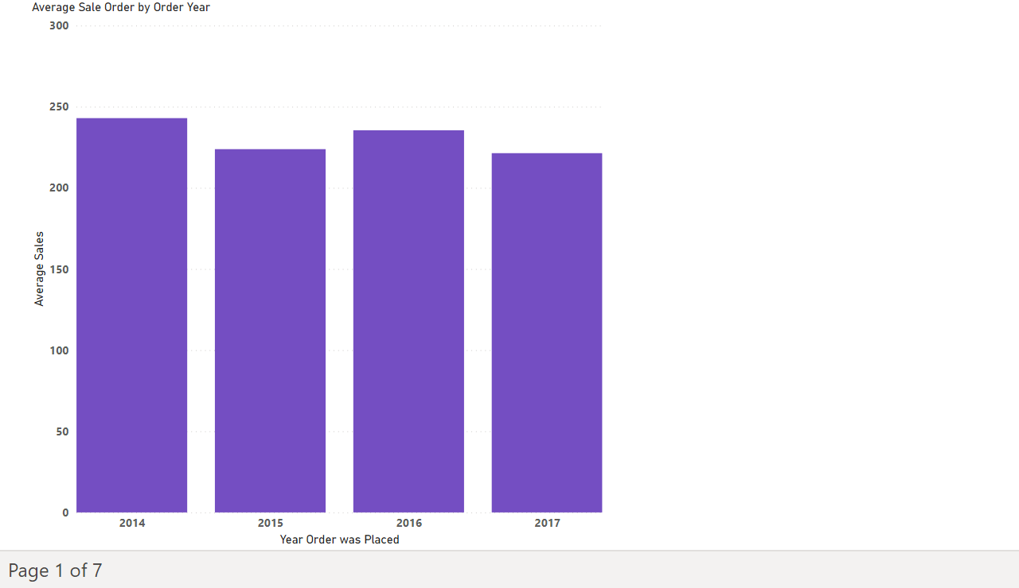
Page 1
Notes:
Average Sale Order by Order Year
No alt text provided

Slide 3
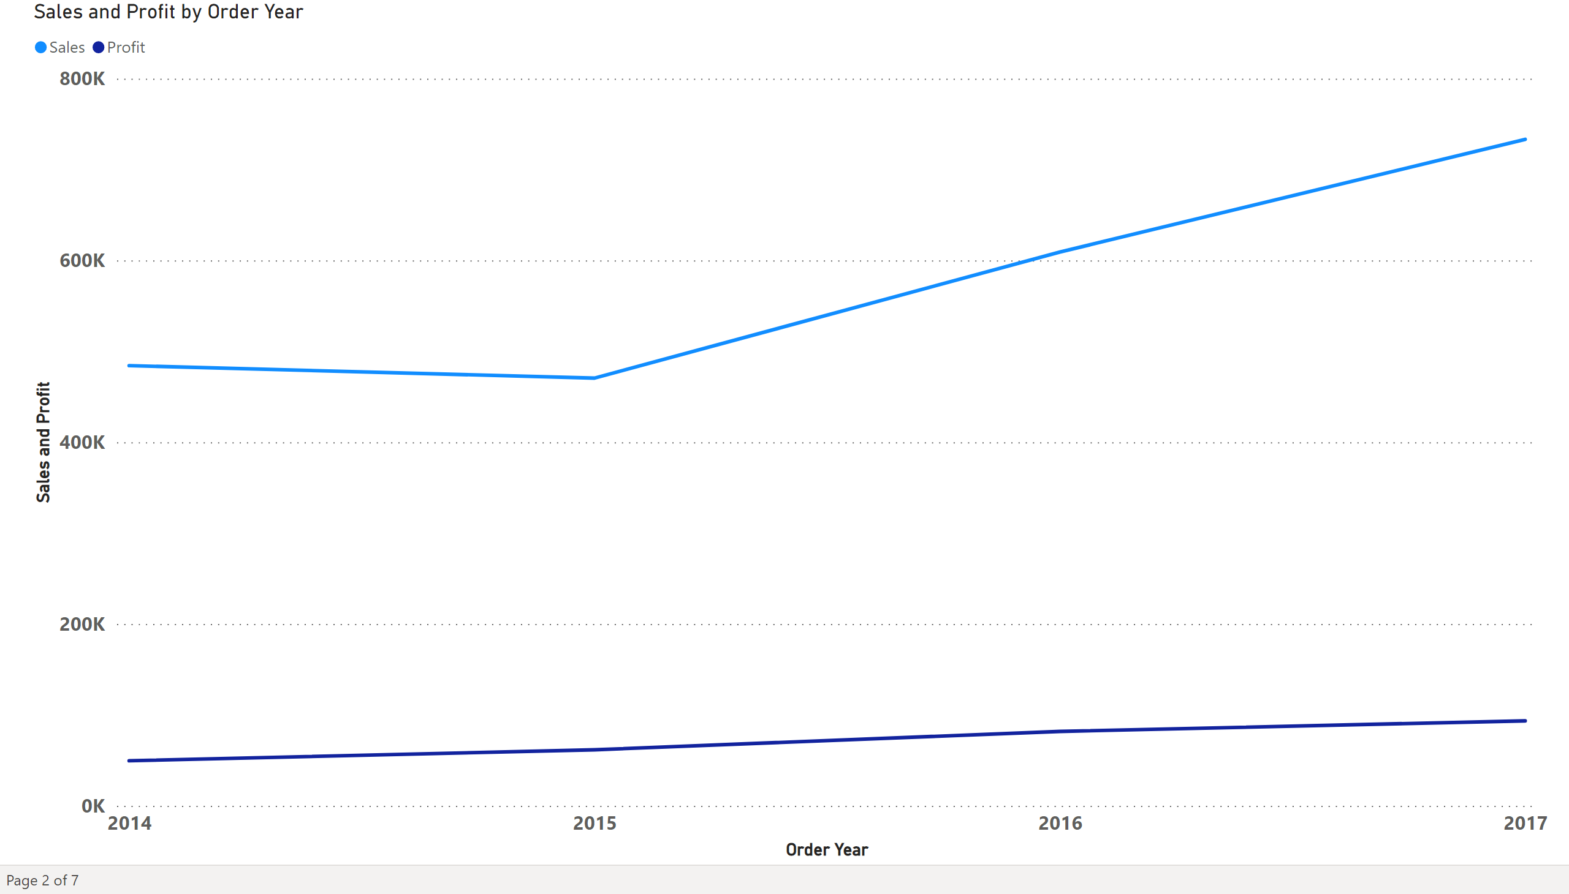
Page 2
Notes:
lineChart
No alt text provided

Slide 4
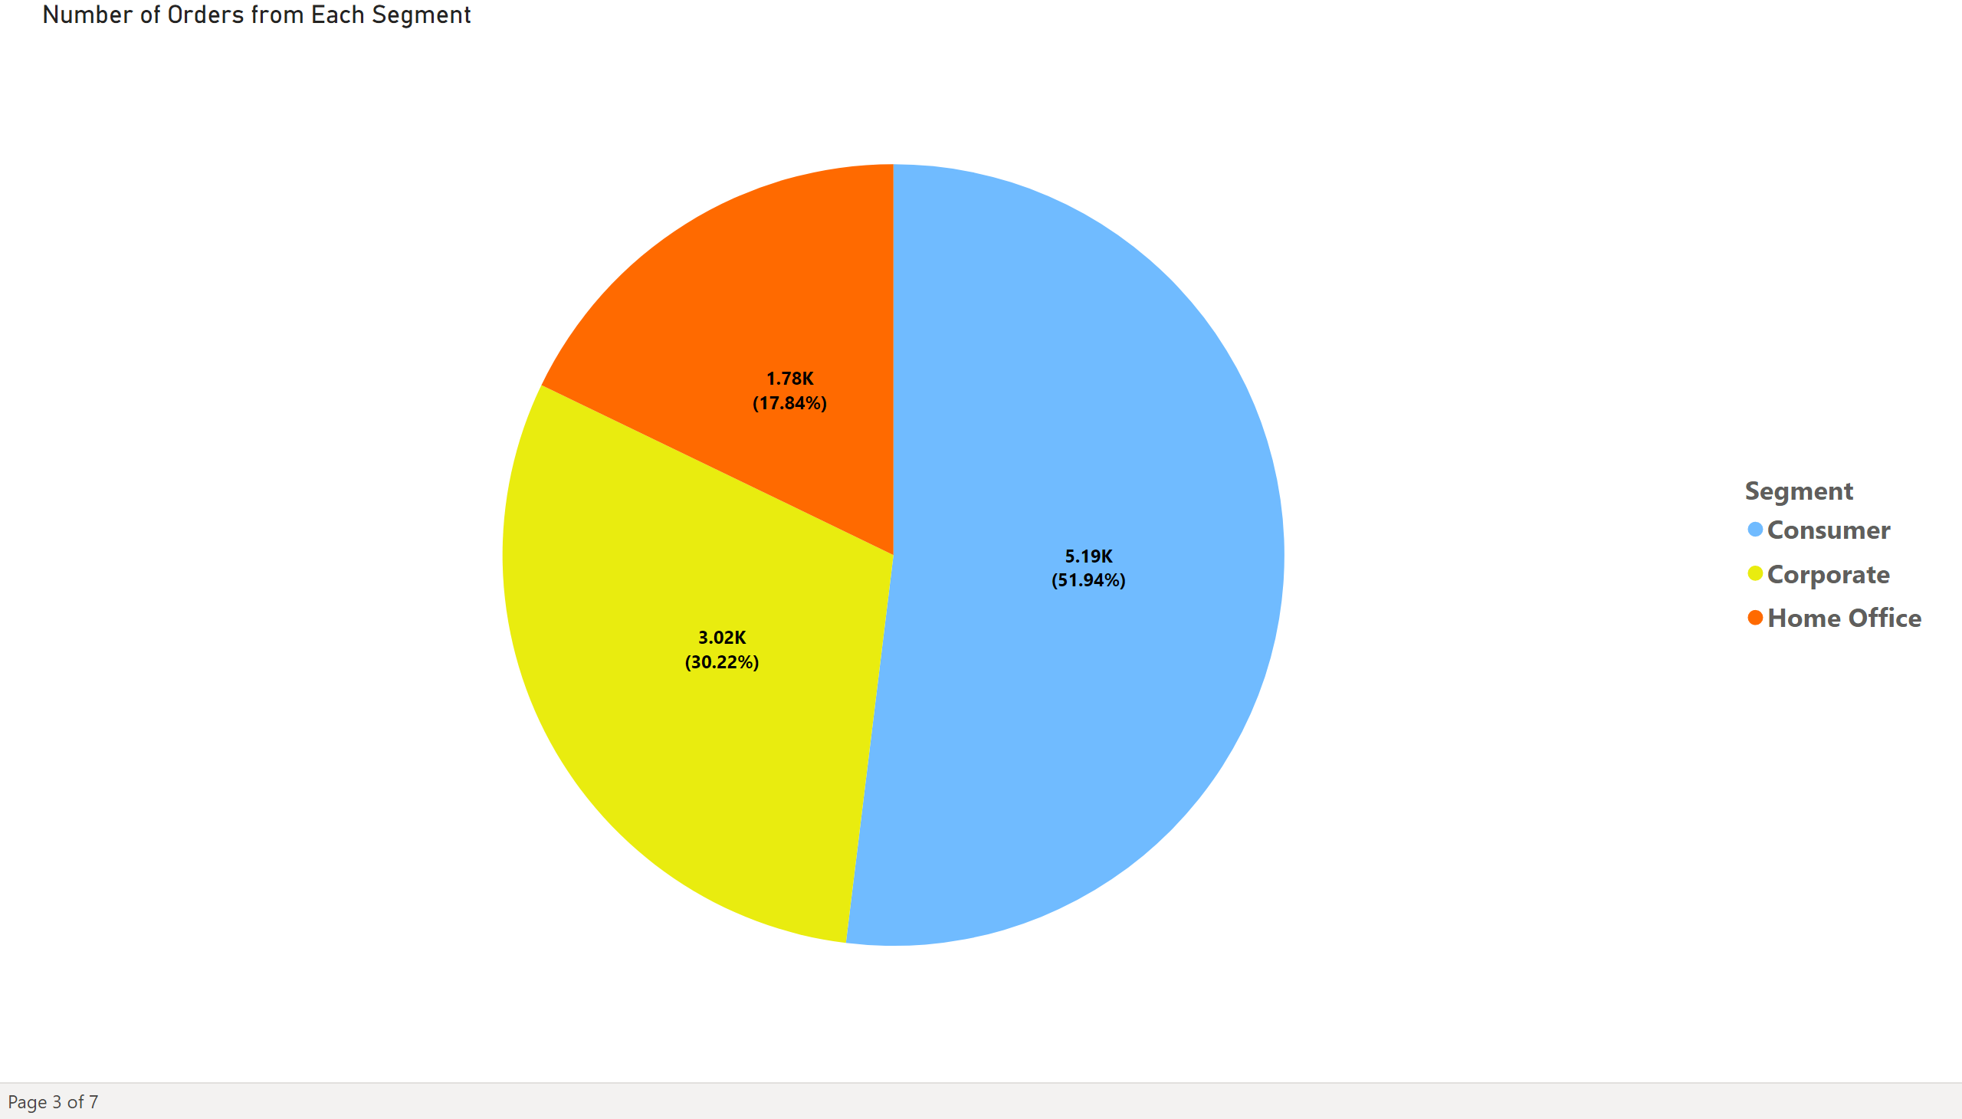
Page 3
Notes:
Number of Orders from Each Segment
No alt text provided

Slide 5
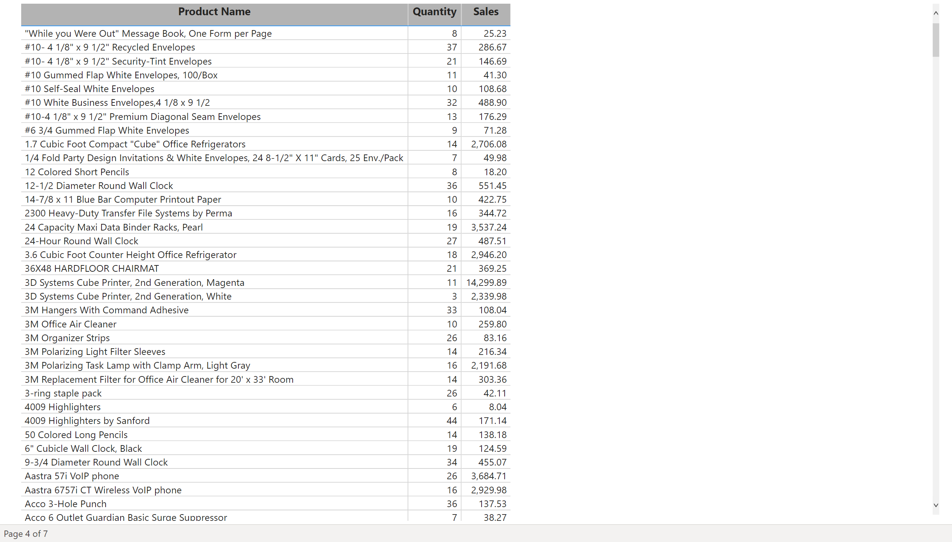
Page 4
Notes:
tableEx
No alt text provided

Slide 6
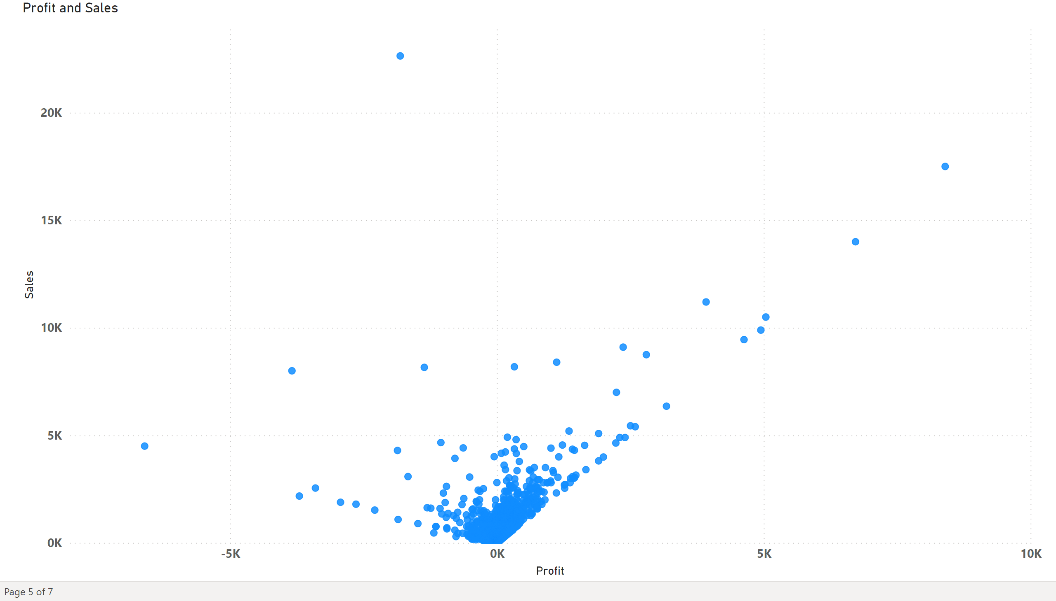
Page 5
Notes:
scatterChart
No alt text provided

Slide 7
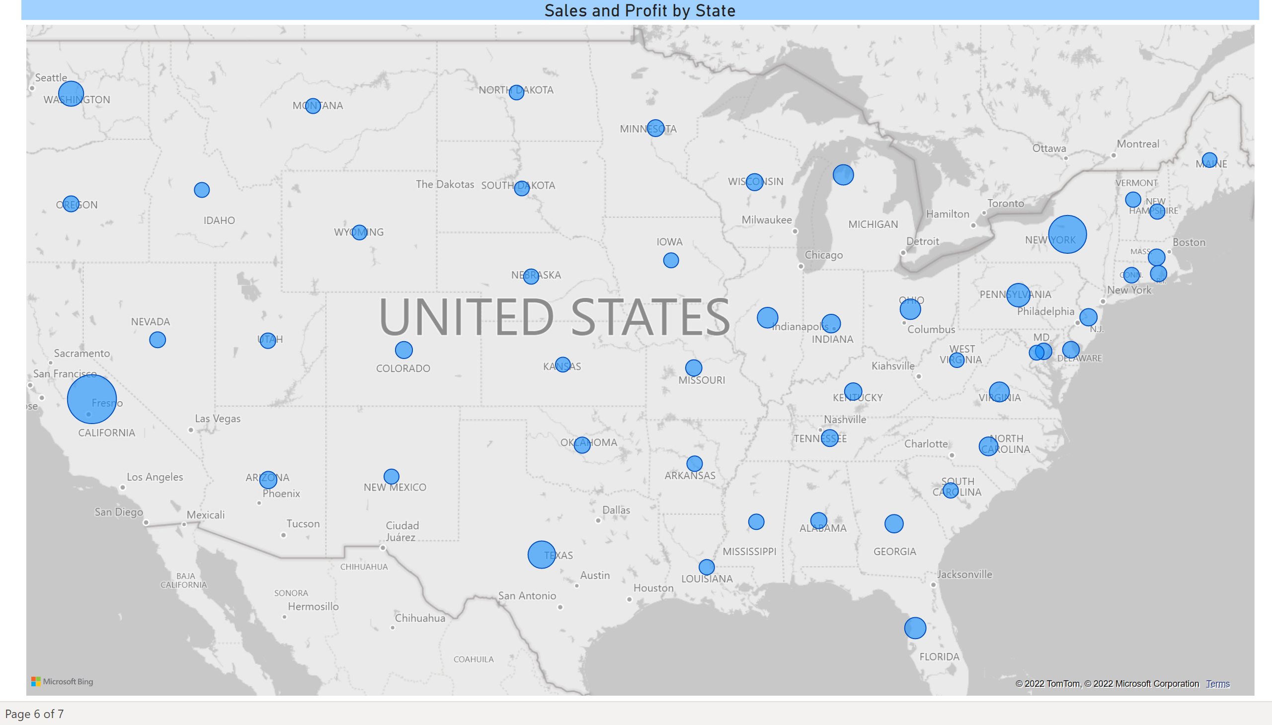
Page 6
Notes:
map
No alt text provided

Slide 8
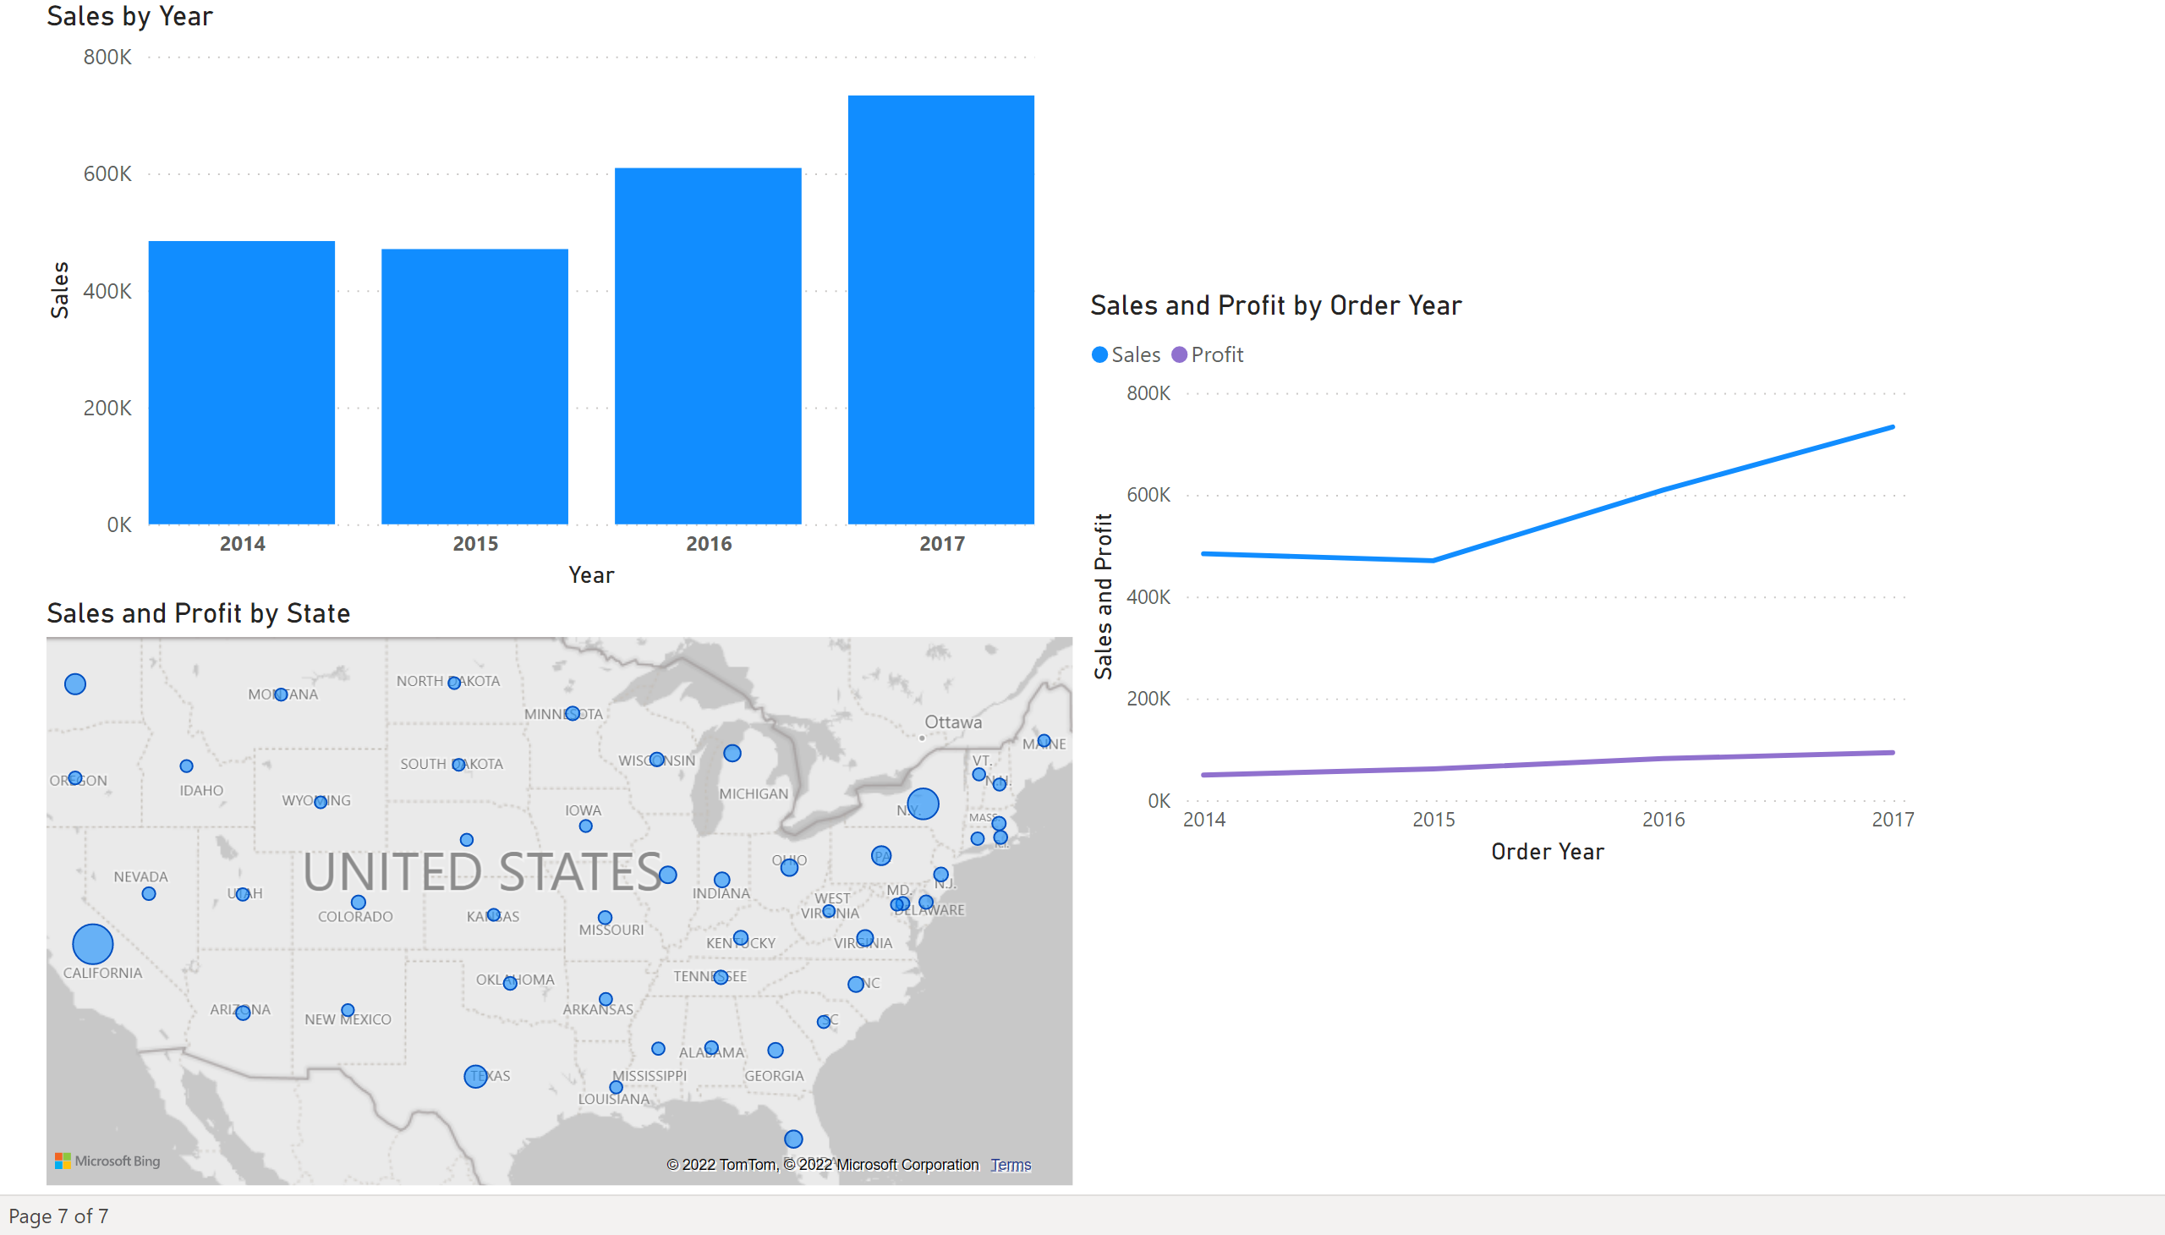
Page 7
Notes:
lineChart
No alt text provided
map
No alt text provided
columnChart
No alt text provided

